Slide 1

Technology Stocks Index
-- CSYE7200 Final Project
Team2:
Yukun Yuan
Dingming He
Ran Zhou

Slide 2
Goal of Project
Design a concept named Technology Stock Index which can measure the risk and investment value of the technology stocks
Estimating the risk of a portfolio investment and provide reference for stocks investor.

Slide 3
User Case
Investor can input the portfolio investment and our system will generate risk expectations for these stocks and the values of Technology Stock Index
The System will recommend you that whether this combination is worth

Slide 4
Methodology
Parse Data and make data cleaning(ETL process)
Design and implement the algorithm models(For single company)
Design and implement the model for Technology Stock Index
Train the models on Spark
Implement the result integration and visualization

Slide 5
About Data
We are going to collect daily stocks data of 8 important technology companies during 3+ yrs;
Data Sources: Real-time Stocks data(Yahoo API：https://github.com/fsw0422/yahoo-finance-history-fetcher);
Data Column: Date, Open, High, Low, Close, Volume, Adj Close;
Data Rows: At least 30,000 rows

Slide 6
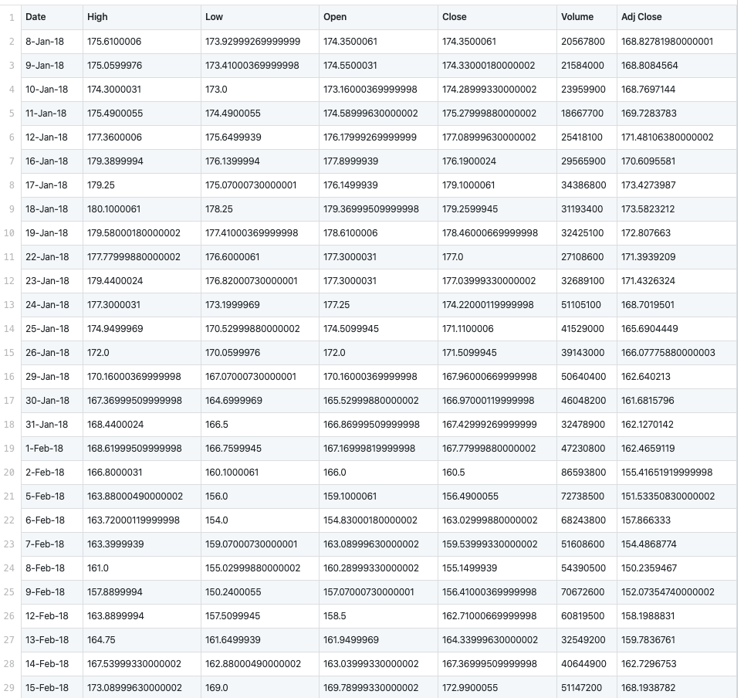
Data Example
We select 8 different stocks
AAPL(Apple)
AMZN(Amazon)
FB(Facebook)
IBM(IBM)
GOOG(Google)
ORCL(Oracle)
MSFT(Microsoft)
BABA(Alibaba)
We need these items:
Date
Close Price
Volumes
Date: Until March 20th 2020
Data Example(Stock: Apple)

Slide 7
Data Example
We select 3 different factors
Crude Oil
Gold
TLT(Tresury Bonds)
We need these items:
Date
Close Price
Date: Until March 20th 2020
Data Example(Factor: Apple)

Slide 8
How to Implement
Main parts of the project
Data cleaning: parse, filter and transform
Value of Risk Algorithm Model
Technology Stock Index Algorithm Model
Result Integration and Visualization
Unit tests
Git Repository: https://github.com/MrYuan123/CSYE7200-Final

Slide 9
Acceptance Criteria
For the result of model, and the average of accuracy should reach at least 30%
The user can get respond in 3 seconds
Provide the visualization of the Technical Index

Slide 10
Algorithm Design
(VaR Algo)
Import Data
Define the Linear Regression
(factors → stock)
Define the mult-variable Distribution
(factors)
Sample the Market Factors
Generate the Random Number
Generate the Lost of this Stock
Algo Arrow Diagram
The most important thing is the Random number, we must make sure it is 100% random
When we perform the project on Spark, the number of threads and the number of trials can make huge impact on efficiency
When get the result list of trials, we need to convert that as the one specific value(VaR) under certain confidential interval(We take 95% as the threshold)
Because the samplings are highly parallel, so Spark makes huge difference

Slide 11
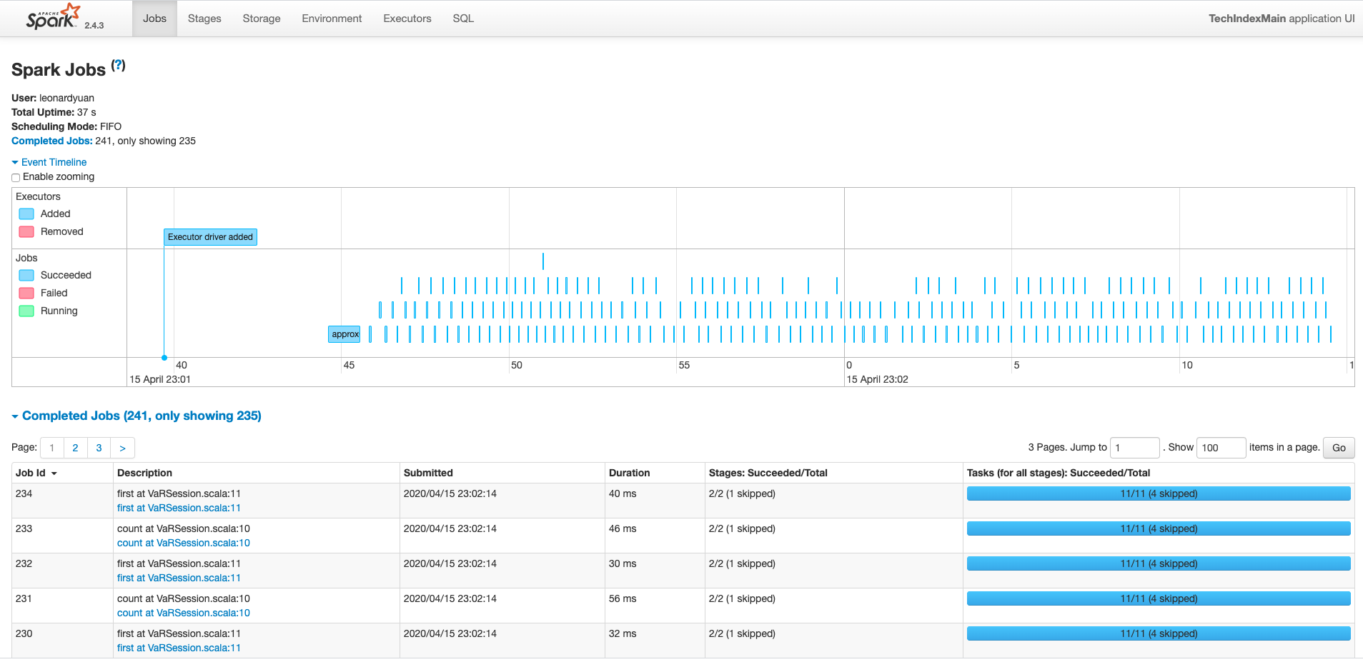
Train On Spark
Pack up the Project as a Jar file
$ sbt package
Run the Project at Spark(local mode)
$ spark-submit /Users/leonardyuan/codebase/CSYE7200-Final/7200_Final_TechIndex/target/scala-2.11/7200_final_techindex_2.11-1.0.jar

Slide 12
Algorithm Evaluation
How to evaluate the efficiency
Since we have multi-parameters models toward the stocks, we can regard the history data as input, and calculate the percentage of matching
P-value = ∑(size - (Failure(stock))) / size
Why accuracy is low?(make sense? or not?)
numTrials | Parallelism | Highest P-Value
100 | 10 | 4.2%
200 | 10 | 6.7%
10000 | 10 | 12.3%
1000000 | 10 | 16.8%

Slide 13
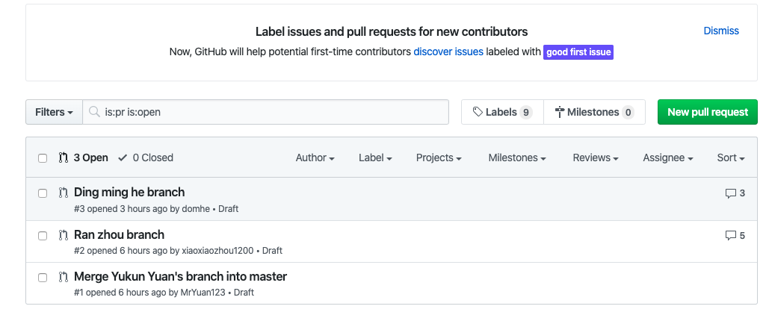
Codebase Management
We use Pull Request to review code
Create Own Branch → Create Draft Pull Request → Convert to PR(Code Reviews) → Merge

Slide 14
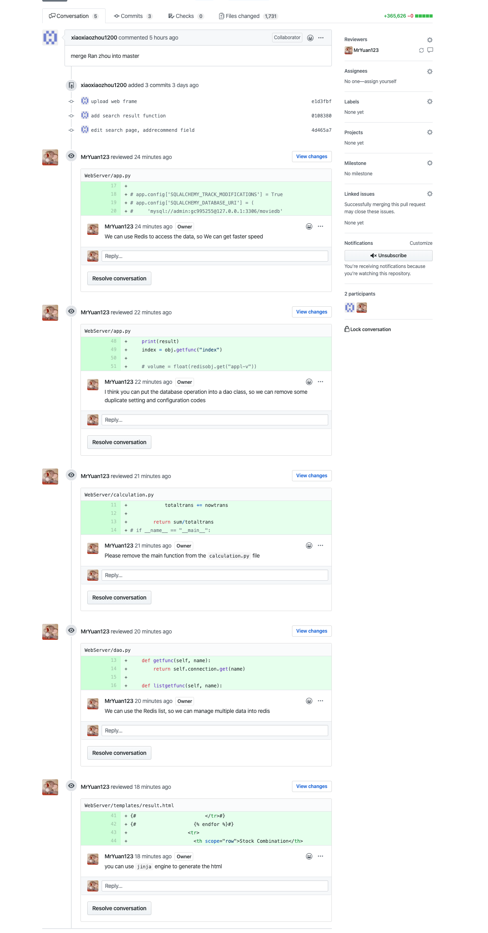
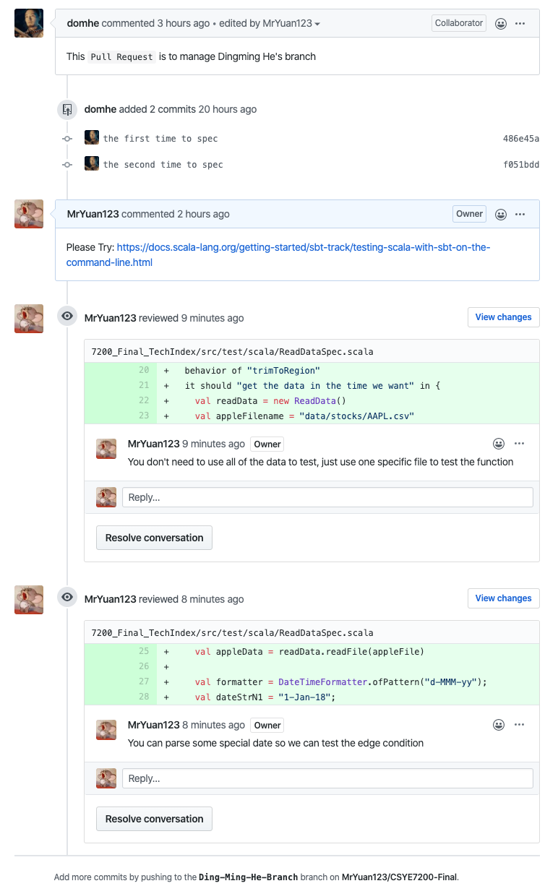
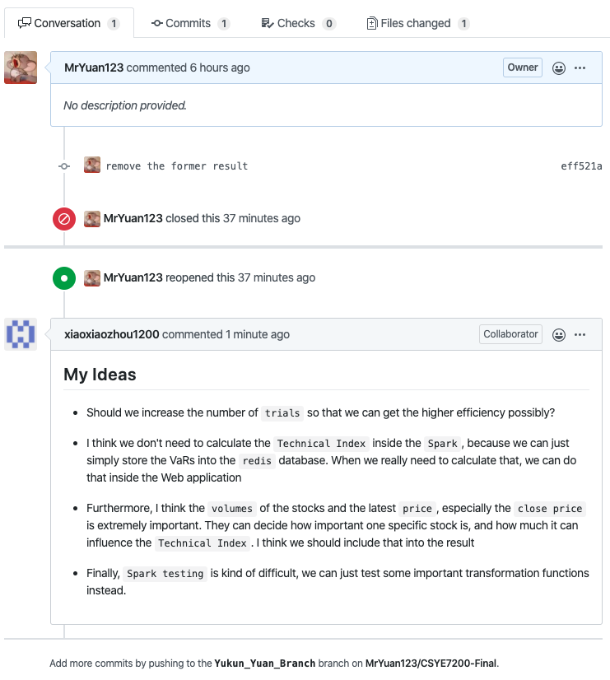
Codebase Management
Pull Request Management
Yukun’s Pull Request
Dingming’s Pull Request
Ran’s Pull Request

Slide 15
Milestones
Model Implementation
Train Model on Spark
Start
4.2
4.11
Data Prasing and Cleaning
Integration and Visualization
3.16
4.6
Unit Test
4.16

Slide 16
Result Demonstration -
Web Development
Framework & Tools: Flask, Python
Data Cache: Redis
Web App Development: Build the search engine page and implement data interaction by Flask
Data Interaction: Import the result from Spark Application and Cache data in Redis, and extract indexes and factors by implementing functions in Web application
Demonstration: http://127.0.0.1:5000/

Slide 17
Result Demonstration -
Index Calculation
Tech index is the average of the VaRs corresponding different weight
Assess the impact of each stock on index, we multiply average volume and latest price of stocks to represent the weights in market.
Calculate portfolio’s VaR by adding the product of the volume and price of each stock of the portfolio.
Compare VaR of portfolio with Technology Stocks Index and measure recommendation.

Slide 18

Result Demonstration -
Web Development
Parse Data
Data Filtering
Front End
Redis
VaR of Portfolio
Html(Jinja2)
Redis
Web Application

Slide 19
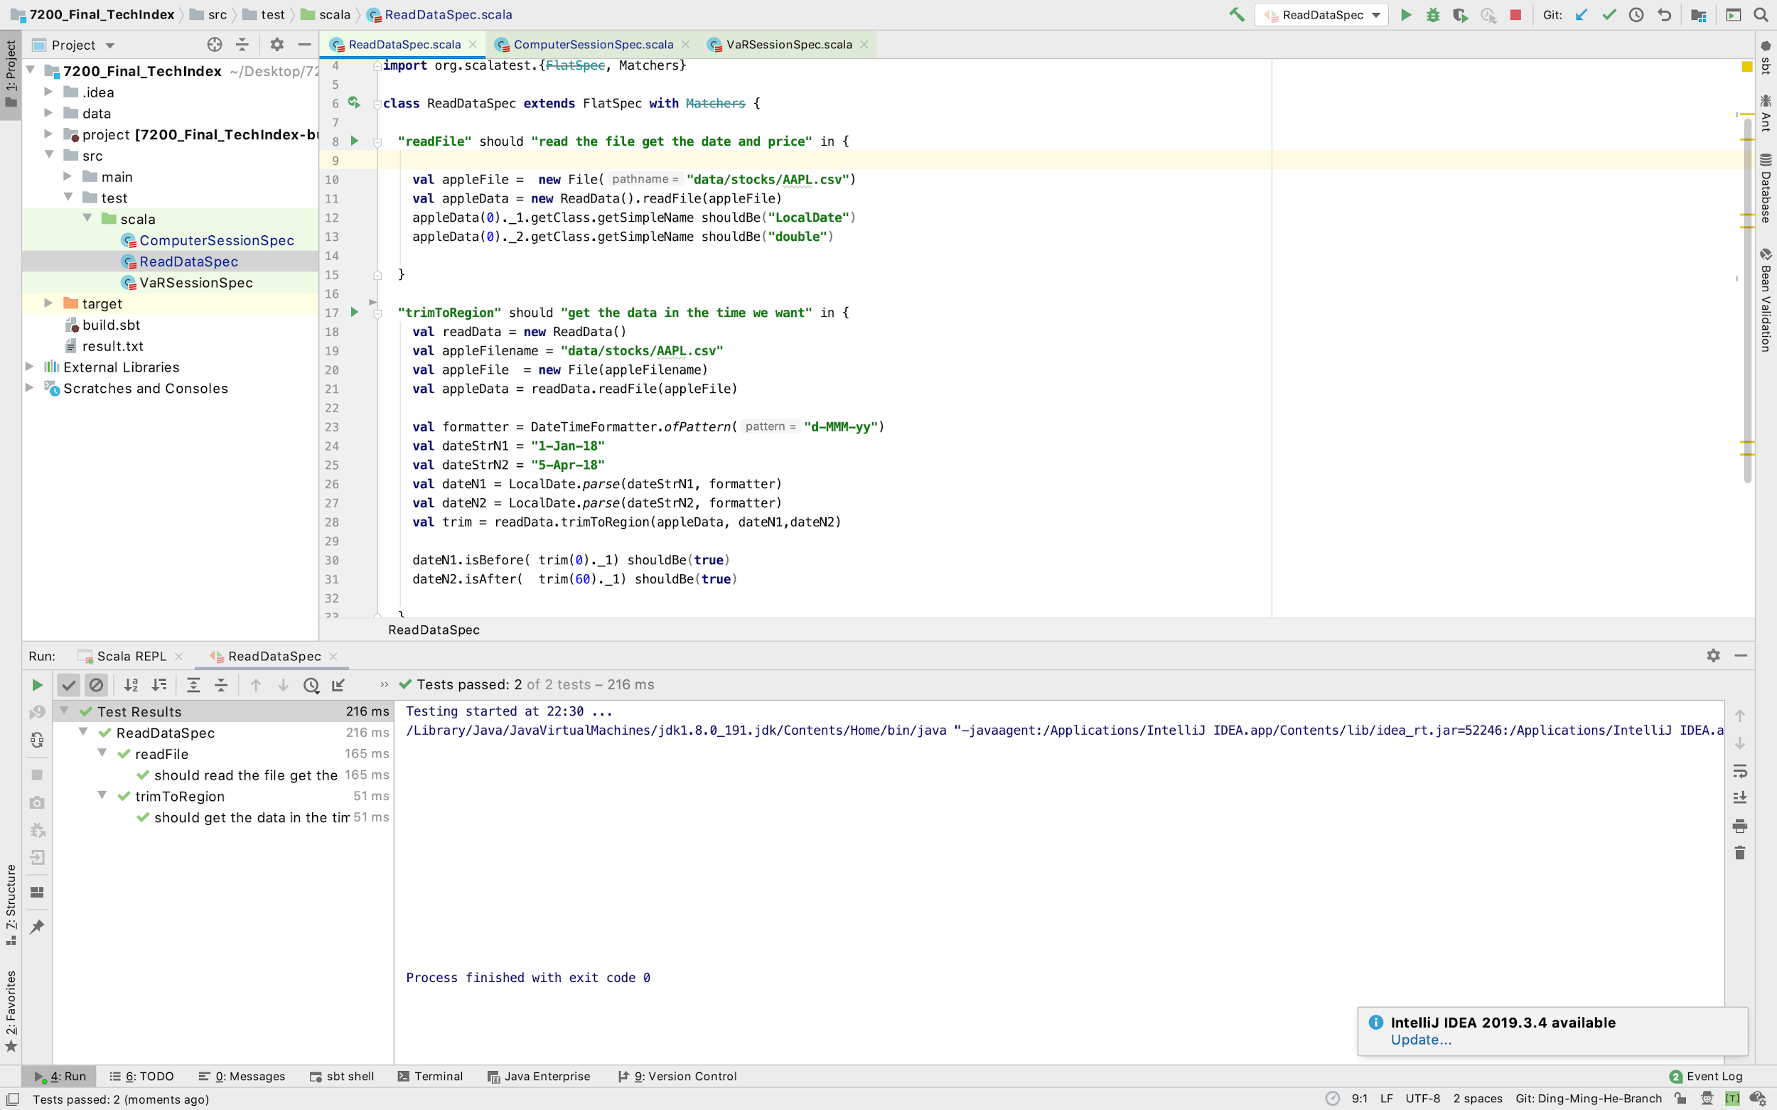
Test

Slide 20
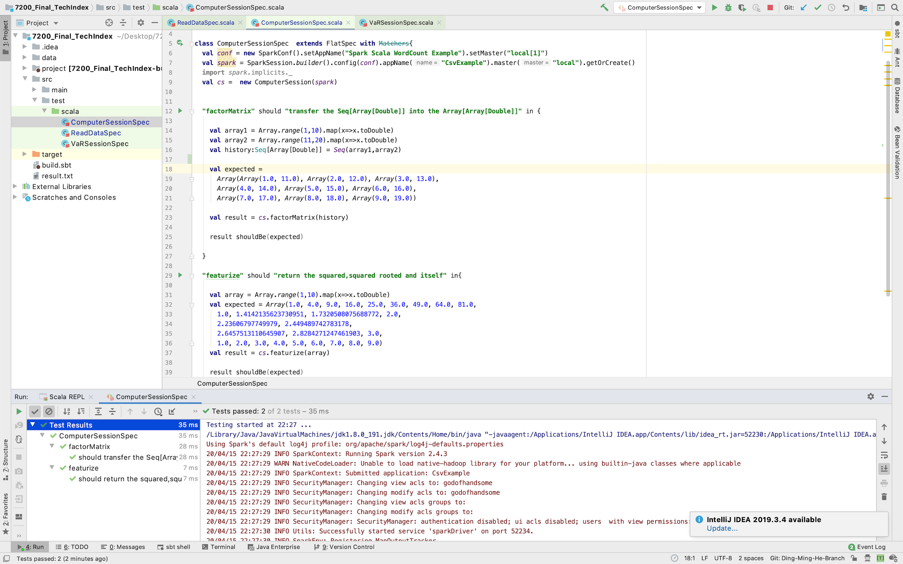
Test

Slide 21
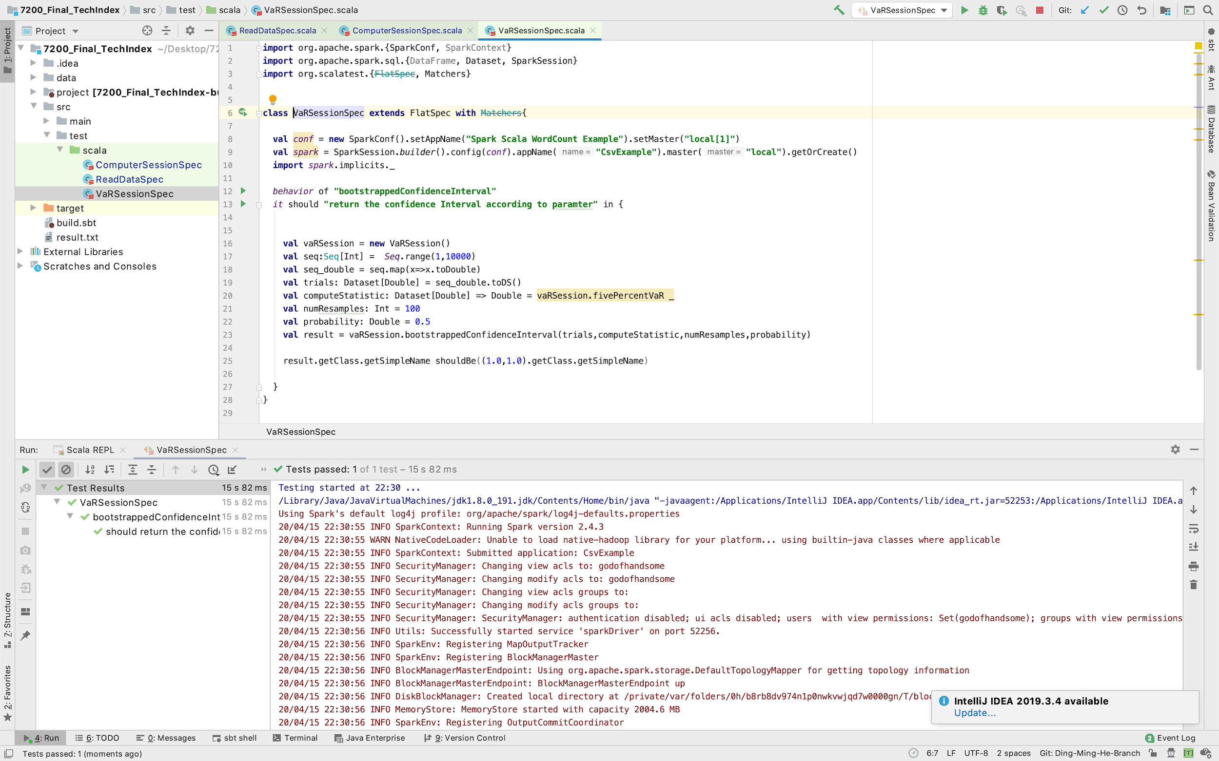
Test

Slide 22

THANKS
2020.04.15

